Slide 1
Eye of the Tiger: A Study of Artificial Life
Shannon Bolton and Nikki Pruitt
Jacksonville State University
Student Symposium
February 17, 2016

Slide 2
Introduction
What is the idea?
What will we use as the creature?
What should be the attributes?
How do they survive?
What tool will we use to demonstrate this?

Slide 3
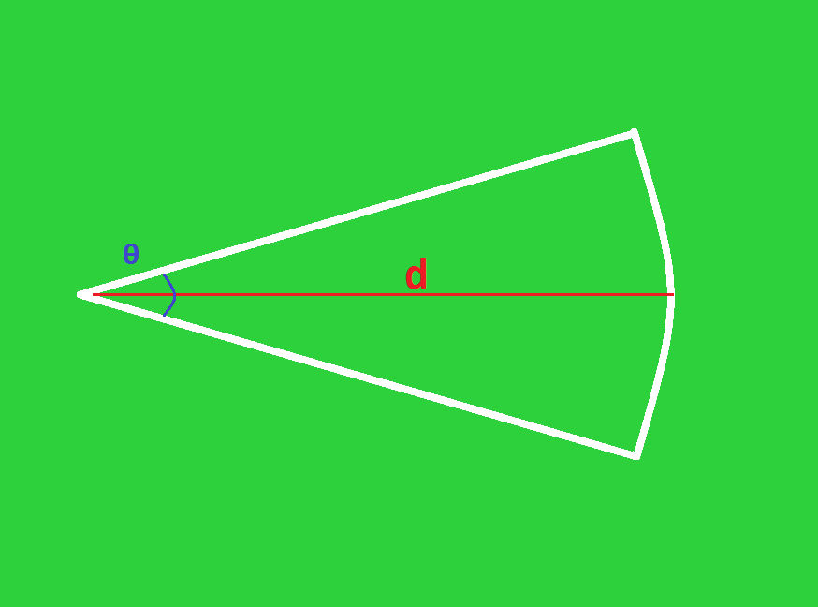
Vision
Vision Sector
Area
Distance

Slide 4
Behavior
Wander – default state
Hunt – prey in sight
Eat – caught prey
Reproduce – spawn a child

Slide 5
Hunt
Prey in sight
Moves at a faster pace
Tries to keep prey in vision sector
What if prey moves out of sight?
Find the prey again
Start wandering after one tick

Slide 6
Reproduce
At max energy a tiger spawns a child
Child’s vision distance based off parent
Gaussian Distribution
Mean is zero
Standard Deviation is based of mutation rate

Slide 7

Population
Kept constant
Under population
Over population

Slide 8
What length cone will work best for hunting?

Slide 9

Obstacles
Rocks
Must go around
Changes line of sight

Slide 10
What length cone will work best when obstacles are placed?

